Slide 1
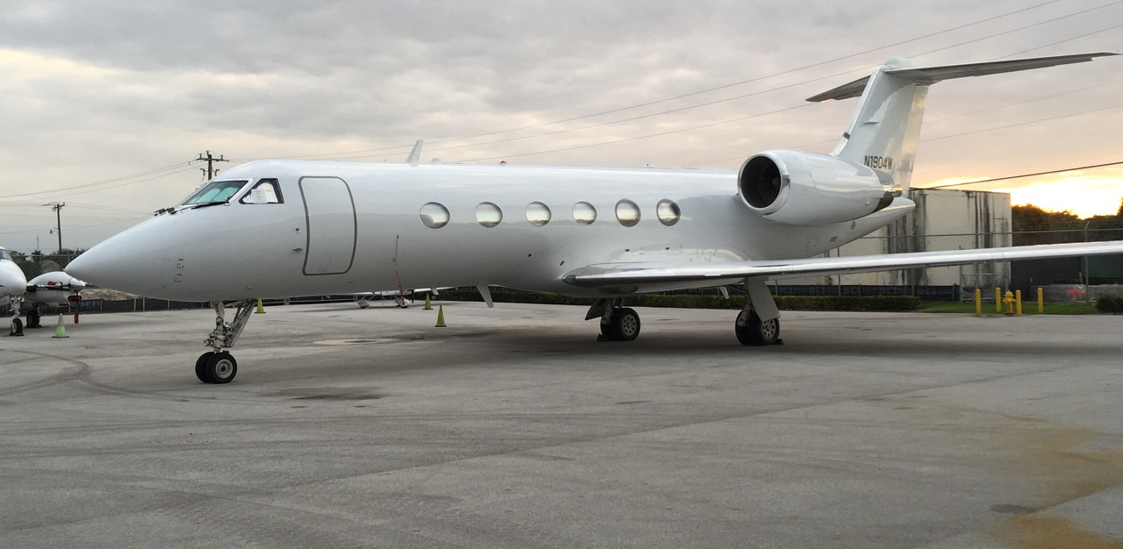
Advising Buyers and Sellers In North & South America since 1989
1993 Gulfstream GIV-SP
11501 Lakeside Dr., Suite #6312 Doral, FL 33178 U.S.A. Tel. 305-445-4888 | Fax. 305-397-1162
www.aerocraft.com | info@aerocraft.com

Slide 2
1993 Gulfstream GIV-SP
Airframe & Engine Information
Aircraft Total Time: 11,074 Hrs | 6,396 Landings
Engines: Rolls Royce TAY 611-8
Engine (1): 10,931 Hrs TSN | 6,992 Cycles
Engine (2): 10,931 Hrs TSN | 6,992 Cycles
APU: Honeywell GTCP-36-100| 4,929 Hrs
11501 Lakeside Dr., Suite #6312 Doral, FL 33178 U.S.A. Tel. 305-445-4888 | Fax. 305-397-1162
www.aerocraft.com | info@aerocraft.com

Slide 3
1993 Gulfstream GIV-SP
Avionics
Honeywell SPZ-8000 EFIS
Triple Honeywell Laseref II Inertial Reference Units
COMMS: Dual Collins VHF-422C w/ 8.33 spacing
NAVS: Dual Collins VIR-432
DME: Dual Collins DME-442
FMS: Dual Honeywell NZ-2000 w/dual GPS
RADAR: Honeywell Primus 880 w/ turbulence detection
TCAS: Honeywell TCAS-2000 w/change 7
Honeywell EGPWS w/ Windshear system
11501 Lakeside Dr., Suite #6312 Doral, FL 33178 U.S.A. Tel. 305-445-4888 | Fax. 305-397-1162
www.aerocraft.com | info@aerocraft.com

Slide 4
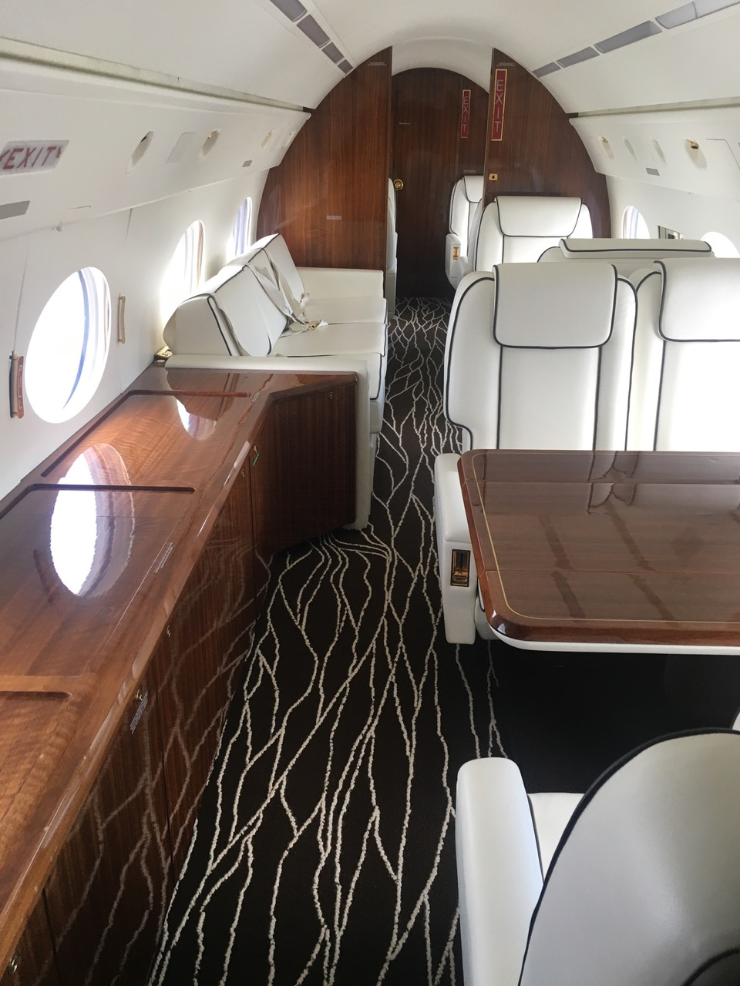
1993 Gulfstream GIV-SP
Features
FEATURES
FM Immunity
RNP 5-10
Fairchild F-1000 Digital FDR
LED Interior Lighting
Fairchild FA-2100 Digital CVR
Convection Oven/Microwave/Dual Coffee
Maker RVSM Certified
Bose Passenger Audio System
Artex 110-406 ELT
Airshow/Rosen 400 Video
Honeywell SAT AFIS
CD/DVD Entertainment/Information System
MAINTENANCE
Operation 1,4,5 &6 Inspections Completed: July 2016
Operation 7 (36-month) & 8 (72-month) Due: February 2018
Damage History: No
11501 Lakeside Dr., Suite #6312 Doral, FL 33178 U.S.A. Tel. 305-445-4888 | Fax. 305-397-1162
www.aerocraft.com | info@aerocraft.com

Slide 5
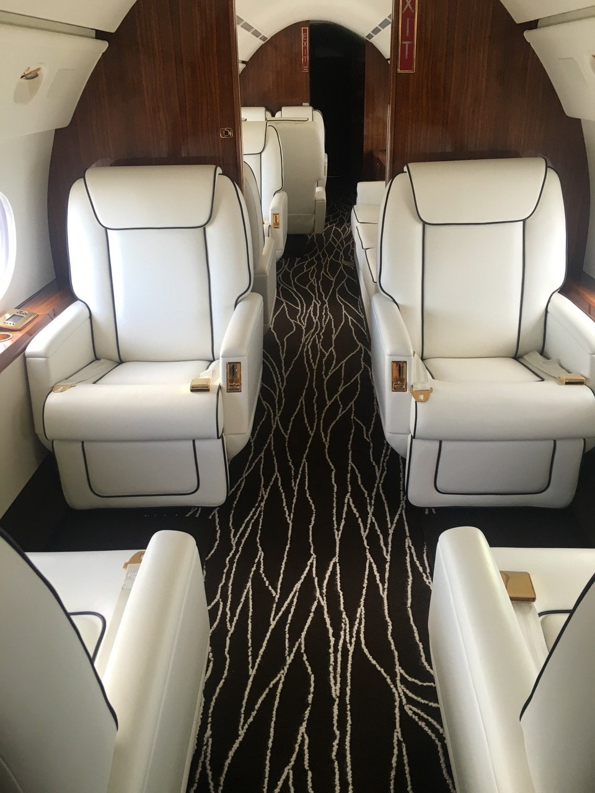
1993 Gulfstream GIV-SP
Exterior& Interior
INTERIOR
New 2016. Thirteen-passenger fireblocked interior
Forward club seating arrangement and mid-Cabin three seat
Divan opposite two club seats
Aft double club seats with table
Ivory white carpet throughout cabin
Aft forward potty and full Aft lavatory with sink
LED Lighting
Personal Entertainment Monitors at all Club Seat
EXTERIOR
New 2016 Overall White
11501 Lakeside Dr., Suite #6312 Doral, FL 33178 U.S.A. Tel. 305-445-4888 | Fax. 305-397-1162
www.aerocraft.com | info@aerocraft.com

Slide 6
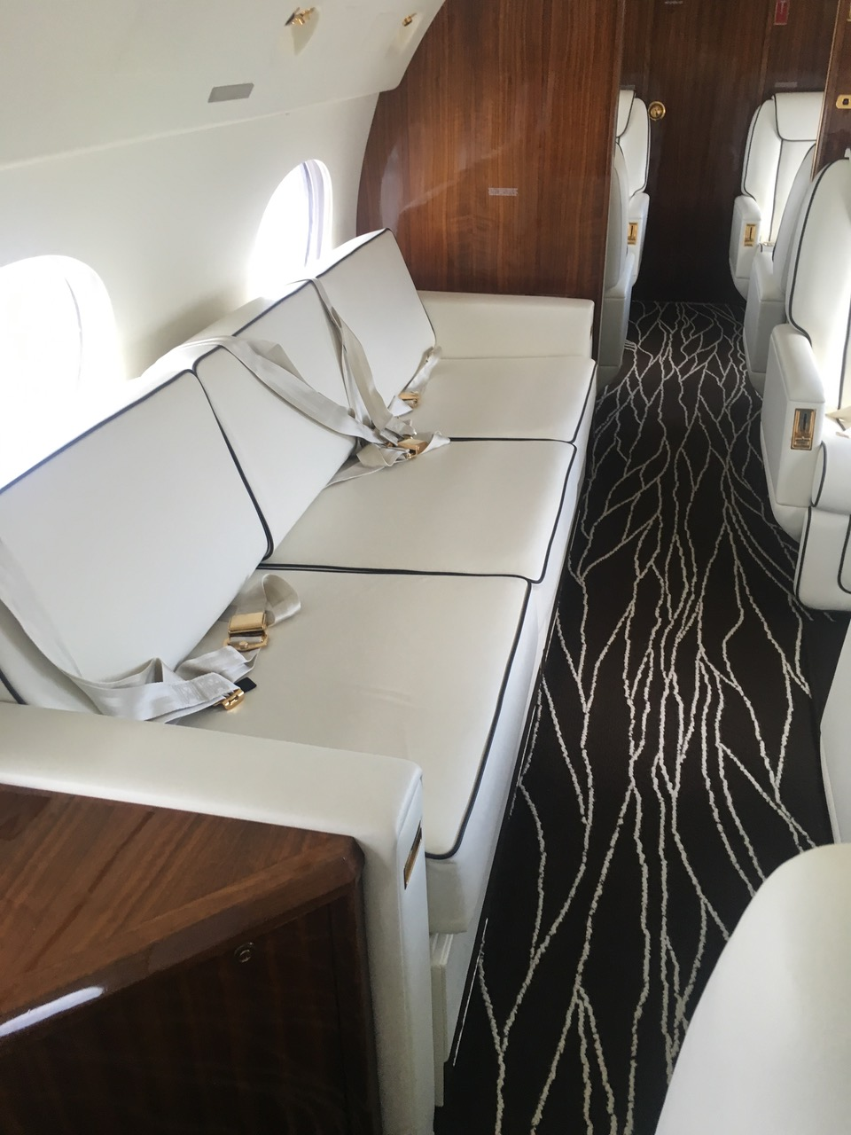
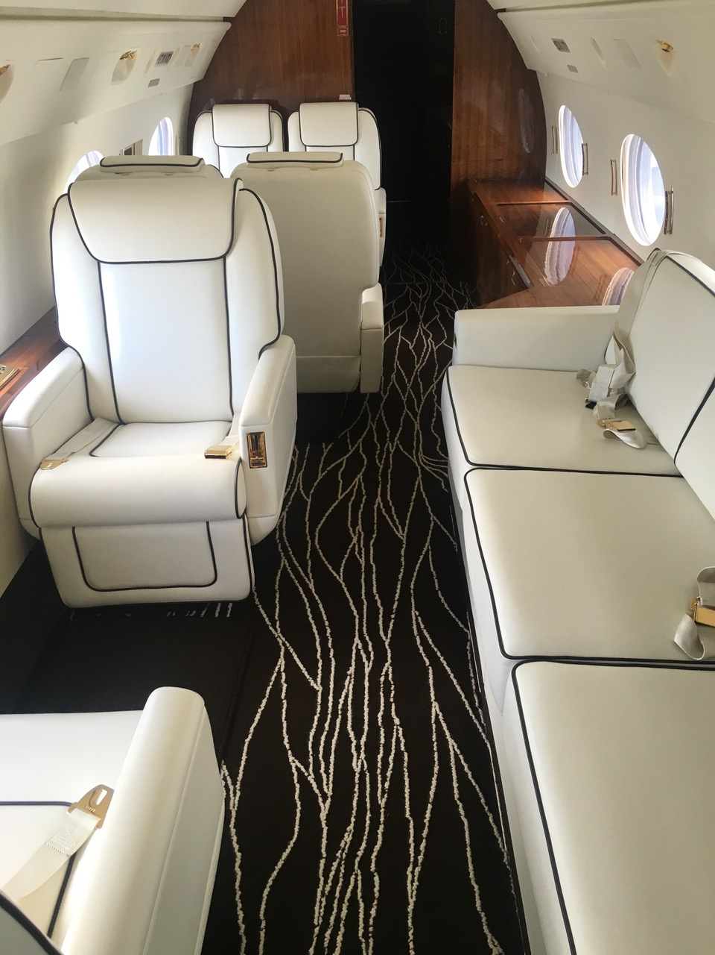
1993 Gulfstream GIV-SP
Exterior& Interior
11501 Lakeside Dr., Suite #6312 Doral, FL 33178 U.S.A. Tel. 305-445-4888 | Fax. 305-397-1162
www.aerocraft.com | info@aerocraft.com

Slide 7
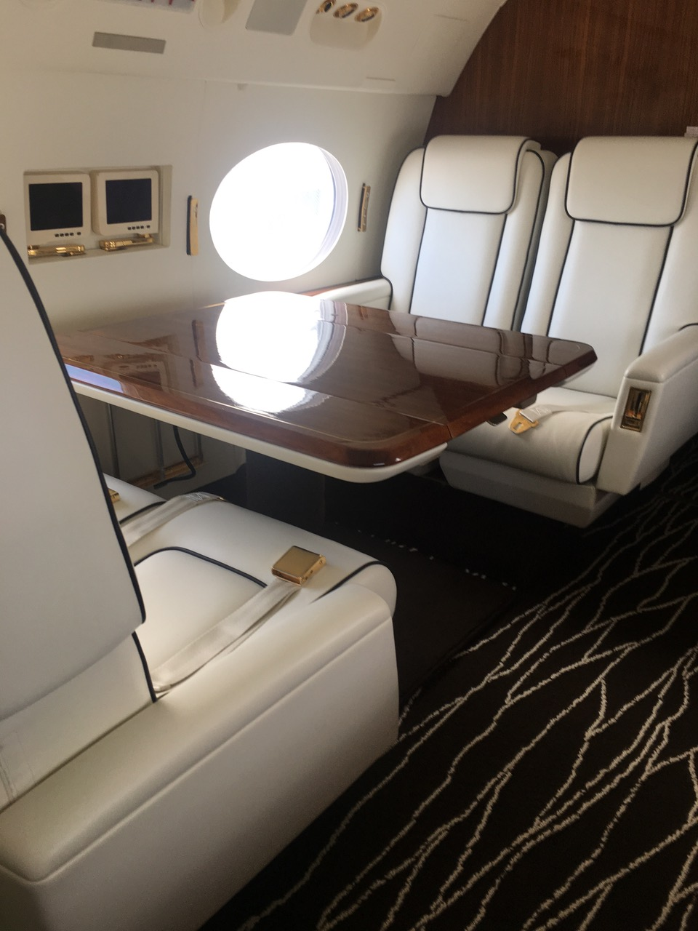
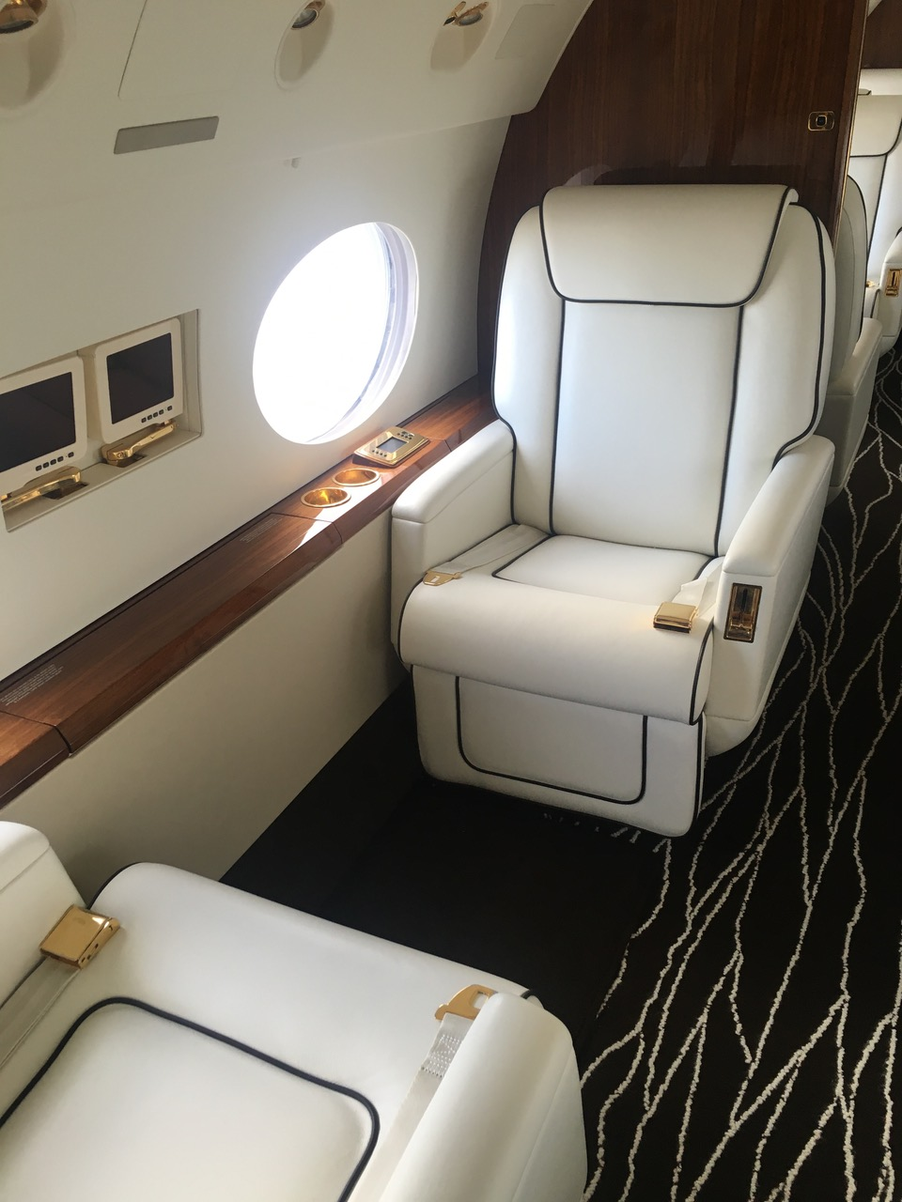
1993 Gulfstream GIV-SP
Exterior& Interior
11501 Lakeside Dr., Suite #6312 Doral, FL 33178 U.S.A. Tel. 305-445-4888 | Fax. 305-397-1162
www.aerocraft.com | info@aerocraft.com

Slide 8
11501 Lakeside Dr., Suite #6312 Doral, FL 33178 U.S.A. Tel. 305-445-4888 | Fax. 305-397-1162
www.aerocraft.com | info@aerocraft.com

